Slide 1
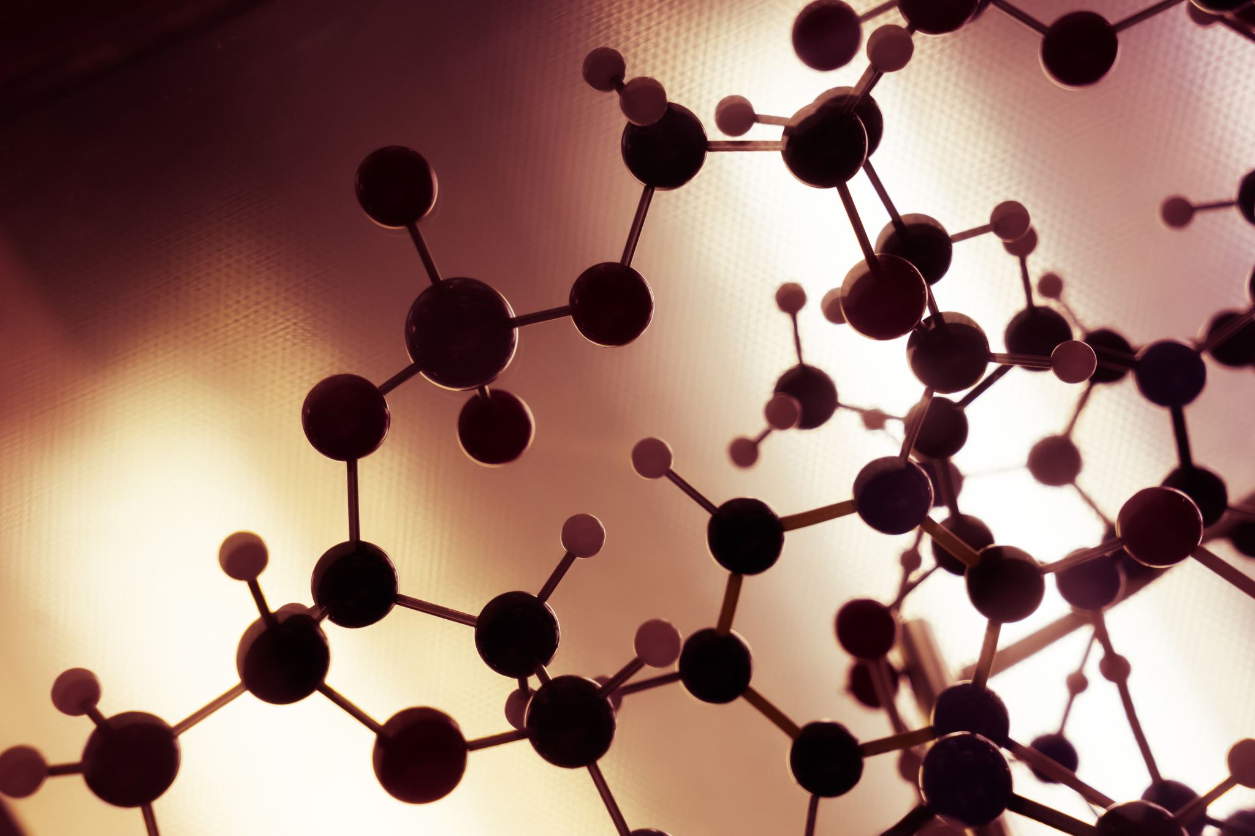

A-1: Astrocyte-derived microparticles initiate a neuroinflammatory cycle due to carbon monoxide poisoning
S.R. Thom, D..Walia, V.M. Bhopale, S..Kalakonda
University of Maryland School of Medicine, Dept . of Emergency Medicine, Baltimore, MD

Slide 2
Introduction: We hypothesized that carbon monoxide (CO) establishes an inflammatory
cycle mediated by microparticles (MPs) based in part on prior work (Toxicol Appl Pharmacol 273: 410, 2013). Further, as we have reported that HBO₂ can inhibit microparticle (MPs) and active NLRP3 inflammasome formation in response to other stresses (J Appl Physiol 126: 1014, 2019), we hypothesized that this anti-inflammatory HBO₂ effect may occur in response to CO poisoning.
Materials and Methods: Using a mouse model of CO poisoning, we evaluated nuclear factor (NF)-κB activation in brain by immunohistochemistry, brain inflammation by Western blot, and generation of MPs by flow cytometry.
Results: After CO poisoning, MPs co-expressing thrombospondin (TSP)-1 and astrocyte-specific glial fibrillary acidic protein (GFAP) are elevated in deep cervical lymph nodes (CLN) that drain the brain glymphatic system. These MPs gain access to the blood stream and activate neutrophils to generate a new family of MPs and stimulate endothelial cells disturbing the blood-brain barrier as assessed by leakage of intravenous 2000 kDa dextran. At the brain microvasculature, neutrophils and MPs sequester, and myeloperoxidase activity result in elevations of the p65 subunit of NF-κB, serine 536 phosphorylated p65, CD36, and loss of astrocyte aquaporin-4 that persist for at least 7 days. Knock-out mice lacking the CD36 membrane receptor are resistant to all CO inflammatory changes. Wild type mice exposed to 2.8 ATA O₂ for 45 minutes following CO poisoning also fail to exhibit all inflammatory changes. Events triggered by CO are recapitulated in naïve wild type mice injected with cervical node MPs from CO-exposed mice. All MPs-mediated events are inhibited in mice infused with a NF-κB inhibitor or anti-TSP-1 antibodies.
Summary: Astrocyte-derived MPs expressing TSP-1 establish a feed-forward neuroinflammatory cycle involving endothelial CD36-to-astrocyte NF-κB crosstalk. HBO₂ appears to function as a novel anti-inflammatory agent to abrogate CO-initiated events.
ABSTRACT

Slide 3
INTRODUCTION
Carbon monoxide (CO) is a common world-wide poison estimated to effect ~137 people per million annually, although incidence is higher in some developing countries (1-3). Cognitive, psychological, vestibular and motor impairments occur in ~25-50% of survivors from severe CO poisoning (4,5). The etiology for neurological deficits that arise from days to weeks after poisoning remains unclear, as risk correlates poorly with hypoxic stress assessed by blood carboxyhemoglobin (COHb) levels. Patients with neurological sequelae show gradations of demyelination and cerebral white matter changes by magnetic resonance imaging (MRI) with elevations of myelin basic protein (MBP) in cerebrospinal fluid (6-9).
Our investigation used a murine model previously shown to involve MBP alterations leading to neurological dysfunction and explored the role of inflammatory microparticles (MPs) in CO poisoning (10-12). MPs are one of a variety of so-called extracellular vesicles that play roles in cell-to-cell communication and inflammation (13). CO neuropathology can be transmitted to naïve mice by injections of MPs isolated from the blood of CO-poisoned mice (14). Neutrophils are involved with the MPs insults because myeloperoxidase (MPO) null knockout mice are resistant to injuries from MP infusions (14). CNS-generated MPs can collect in the deep cervical lymph nodes and some are liberated to the blood stream (15).
Neutrophil activation occurs in acutely CO poisoned patients (11). This also occurs in our murine model and drives cerebral microvascular oxidative stress causing alterations in MBP that, in turn, lead to an adaptive immunological response and functional neurological deficits (10-12). Events are abrogated by neutropenia, antioxidants or inhibiting neutrophil adherence (one action of HBO₂). There is no explanation for why neutrophils are activated, why they target the neurovasculature, nor how neuroinflammation is perpetuated so that functional deficits are manifested weeks after CO exposure.
We hypothesized that intra-CNS responses to CO would be reflected by changes in the MPs that exit the brain via the glymphatic system. Once these MPs gain access to the blood stream, they could activate neutrophils due to expression of proteins such as thrombospondin-1 (TSP-1), a product generated by activated astrocytes. Further, we hypothesized that HBO2 would abrogate MPs production, neutrophil activation and loss of blood brain barrier integrity.

Slide 4
METHODS
All aspects of this study were reviewed and approved by the Institutional Animal Care and Use Committee. All experiments were performed using young, adult (10–12 weeks) mice with approximately equal numbers of males and females in all experimental groups.
Mice were left to breathe room air (control) or subjected to 1-hour exposure to CO according to an established model of 1000 ppm for 40 minutes and 3000 ppm for 20 minutes (12, 14). In prior studies we demonstrated that this exposure achieves a blood carboxyhemoglobin level of 54% (11, 12). Where indicated, some were exposed to 2.8 ATA O₂ for 45 minutes after CO, and some injected IV with 100,000 cervical node MPs isolated from either a control mouse and one first exposed to CO.
Cervical lymph nodes were identified and removed from mice, and MPs isolated from nodes and blood as has been described previously (15). MPs and neutrophil activation were analyzed by flow cytometry with an 8-color, triple laser MACSQuant® Analyzer (Miltenyi Biotec Corp., Auburn, CA).
Vascular leakage of was quantified after mice were injected with lysine-fixable tetramethylrhodamine-conjugated
dextran (2 x 10⁶ Da, Invitrogen, Carlsbad, CA) with rhodamine fluorescence values normalized to that obtained with
a control mouse included in each experiment (15). Neutrophil sequestration was evaluated by performing Western
blots on tissue homogenates, probing for Ly6G and MPO and normalizing band density to β-actin bands on the same
blots following our published procedures (12, 15).

Slide 5
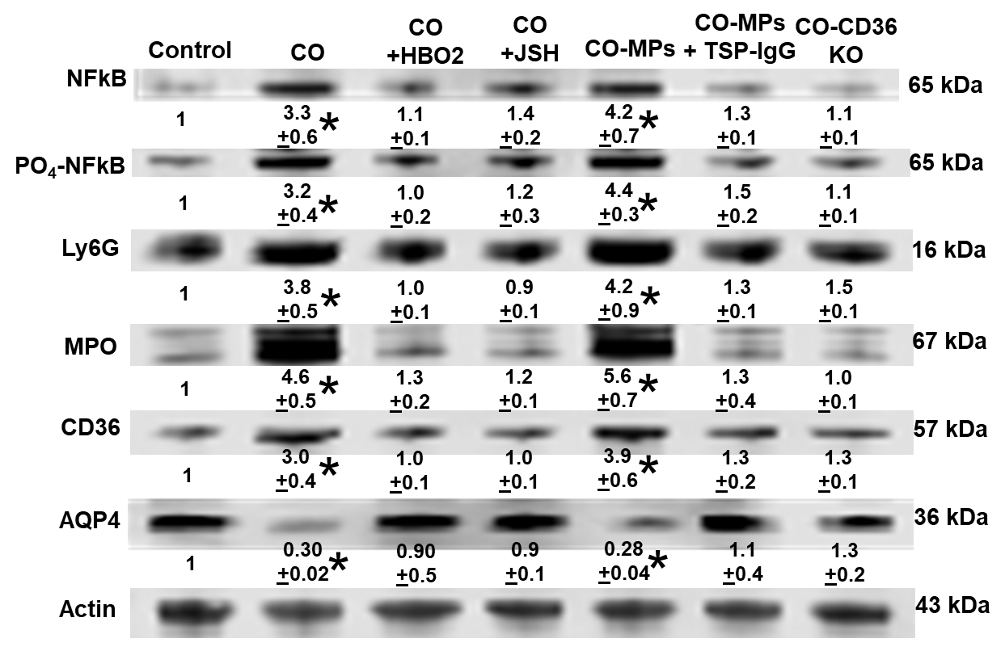
RESULTS
Figure 1
Figure 1: CO exposure causes elevations of MPs in cervical nodes and blood. Effects are abrogated by HBO2, injection of NF-kB inhibitor (JSH) and fail to occur in CD36 knock out mice . Elevations occur when node MPs from a CO-exposed mouse are injected into naïve mice (CO-MPs column) and this is inhibited if antibody to TSP-1 is first combined with MPs. Note MPs elevations post-CO were similar at 7 and 28 days post-exposure (not shown). * indicates p<0.05, ANOVA.
*
Cervical Node MPs
*
*
MPs#/µl NODE prep
Figure 2
*
Figure 2: Brain Western blots post-CO show increased NF-κB and phospho-NF-kB (activation), neutrophil adherence (as Ly6G and myeloperoxidase (MPO) protein, increase in CD36 (membrane receptor) and loss of astrocyte aquaporin (AQP)-4 normalized to cell actin. Manipulations modifying CO events as described in Figure 1 achieved similar effects on Westerns.
*
*
Blood MPs
MPs#/µl plasma
Control (12)
2 hr post-CO (6)
2 hr post CD36KO (6)
Immed post-CO (6)
2 hr post-CO+JSH (6)
2 hr post-CO+HBO₂ (6)
2 hr post-IV CO-MPs (6)
2 hr IV CO-MPs+TSP IgG (6)
Figure 3
*
*
Figure 3: Vascular leak occurs in brain post-CO & with MPs injections. Agents inhibiting MPs & Western blot changes also abrogate brain capillary leak. Dots are individual data points, open circle mean + SE (n=mouse#). * indicates p<0.05, ANOVA.
CO (8)
CO-CD36 KO (8)
CO MPs (6)
CO MPs+TSPIGg (6)
CO+JSH23 (4)
CO MPs+JSH (4)
CO+HBO2 (4)
Control MPs (4)
CO MPs+HBO2 (4)

Slide 6
CONCLUSION
Data can be explained by the cycle shown:
Schematic showing sequence of events initiated by CO. CO first triggers NF-κB activation in astrocytes (inhibited by JSH-23). GFAP/TSP-1 bearing MPs are produced and pass through the glymphatic system, enter the blood stream and activate endothelium along with neutrophils that, in turn, generate new MPs. CD36 is involved as the receptor for MPs on endothelium, also probably on astrocytes and microglia (shown as double arrow). MPO from the newly generated MPs and sequestered neutrophils cause perivascular oxidative stress reflected as production of reactive oxygen species (ROS) that is inhibited by HBO2, along with a contribution from endothelial xanthine dehydrogenase (XD) conversion to oxidase (XO) and lipid peroxidation based on prior studies. These events lead to loss of AQP4 and maintenance of the inflammatory cycle due to continued CD36-mediated NF-κB activation.
CO
Astrocytes
NFκB
MPs with
CNS proteins
to Nodes, then blood
Lipid peroxidation
CD36
XD -> XO -> ROS
Cerebral endothelium
TSP-MPs
CD36
MPs
MPO
PMN
activation

Slide 7

REFERENCES
Funding from Office of Naval Research
(N00014-16-1-2868) and NIH (RO1 DK116199)
are gratefully acknowledged.
1. Raub, J. A., Mathieu-Nolf, M., Hampson, N. B., and Thom, S. R. (2000) Carbon monoxide poisoning--a public health perspective. Toxicology 145, 1-14
2. CDC, C. f. D. C. (2007) Carbon monoxide-related deaths-United States, 1999-2004. MMWR Morb Mortal Wkly Rep 56, 1309-1312
3. Mattiuzzi, C., and Lippi, G. (2020) Worldwide epidemiology of carbon monoxide poisoning. Human and Experimental Toxicology 39, 387-392
4. Hampson, N. B., Piantadosi, C. A., Thom, S. R., and Weaver, L. K. (2012) Practice recommendations in the diagnosis, management, and prevention of carbon monoxide poisoning. Am J Respir Crit Care Med 186, 1095-1101
5. Rose, J. J., Wang, L., Xu, Q., McTiernan, C. F., Shiva, S., Tejero, J., and Gladwin, M. T. (2017) Carbon monoxide poisoning: Pathogenesis, management, and future directions of therapy. Am J Respir Crit Care Med 195, 596-606
6. Beppu, T., Fujiwara, S., Nishimoto, H., Koeda, A., Narumi, A., Mori, K., Ogasawara, K., and Sasaki, M. (2012) Fractional anisotropy in the centrum semiovale as a quantitative indicator of cerebral white matter damage in the subacute phase in patients with carbon monoxide poisoning: correlation with the concentration of myelin basic protein in cerebrospinal fluid. J Neurol 259, 1698-1705
7. Ide, T., and Kamijo, Y. (2009) The early elevation of interleukin 6 concentration in cerebrospinal fluid and delayed encephalopathy of carbon monoxide poisoning. Am J Emerg Med 27, 992-996
8. Kuroda, H., Fujihara, K., Mugikura, S., Takahashi, S., Kushimoto, S., and Aoki, M. (2016) Altered white matter metabolism in delayed neurologic sequelae after carbon monoxide poisoning: A proton magnetic resonance spectroscopic study. J Neurological Sci 360, 161-169
9. Kamijo, Y., Soma, K., and Ide, T. (2007) Recurrent myelin basic protein elevation in cerebrospinal fluid as a predictive marker of delayed encephalopathy after carbon monoxide poisoning. Am J Emerg Med 25, 483-485
10.Thom, S. R., Bhopale, V. M., Fisher, D., Zhang, J., and Gimotty, P. (2004) Delayed neuropathology after carbon monoxide poisoning is immune-mediated. Proc Natl Acad Sci U S A 101, 13660-13665
11.Thom, S. R., Bhopale, V. M., Han, S. T., Clark, J. M., and Hardy, K. R. (2006) Intravascular neutrophil activation due to carbon monoxide poisoning. Am J Respir Crit Care Med 174, 1239-1248
12.Han, S. T., Bhopale, V. M., and Thom, S. R. (2007) Xanthine oxidoreductase and neurological sequelae of carbon monoxide poisoning. Toxicol Lett 170, 111-115
13.Mause, S. F., and Weber, C. (2010) Microparticles: Protagonists of a novel communication network for intercellular information exchange. Circ Res 107, 1047-1057
14.Xu, J., Yang, M., Kosterin, P., Salzberg, B. M., Milovanova, T. N., Bhopale, V. M., and Thom, S. R. (2013) Carbon monoxide inhalation increases microparticles causing vascular and CNS dysfunction. Toxicol Appl Pharmacol 273, 410-417
15.Ruhela, D., Bhopale, V. M., Yang, M., Yu, K., Weintraub, E., Greenblatt, A., and Thom, S. R. (2020) Blood-borne and brain-derived microparticles in morphine-induced anti-nociceptive tolerance. Brain Behav Immun 87, 465-472

